Slide 1
ARP Spoofing (Part I)

Slide 2
Introduction
A computer connected to an IP/Ethernet has two addresses
MAC address
Hardware address / Physical address
Globally unique address stored in the network card.
Ethernet header contains the MAC addresses of the source and the destination computer.
IP address
Each computer in a network must have a unique IP address to communicate.
Virtual and assigned by software.

Slide 3
The Internet Layer (IP) communicates by constructing packets.
Packets are delivered by Ethernet.
Adds an Ethernet header for delivery
Splits the packets into frames
Sends them down the cable to the switch.
The switch then decides which port to send out the frame. By comparing the destination address of the frame to an internal table that maps port numbers to MAC addresses.

Slide 4
When an Ethernet frame is constructed from an IP packet, which has no idea what the MAC address of the destination machine is.
The only information available is the destination IP address.
There must be a way to the Ethernet protocol to find the MAC address of the destination machine, given a destination IP.
This is where ARP, Address Resolution Protocol, comes in.

Slide 5
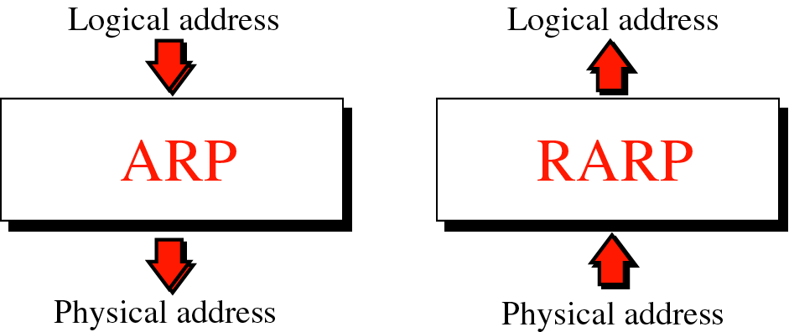
Figure 8-1
Address resolution and Reverse address resolution
(obsolete)

Slide 6
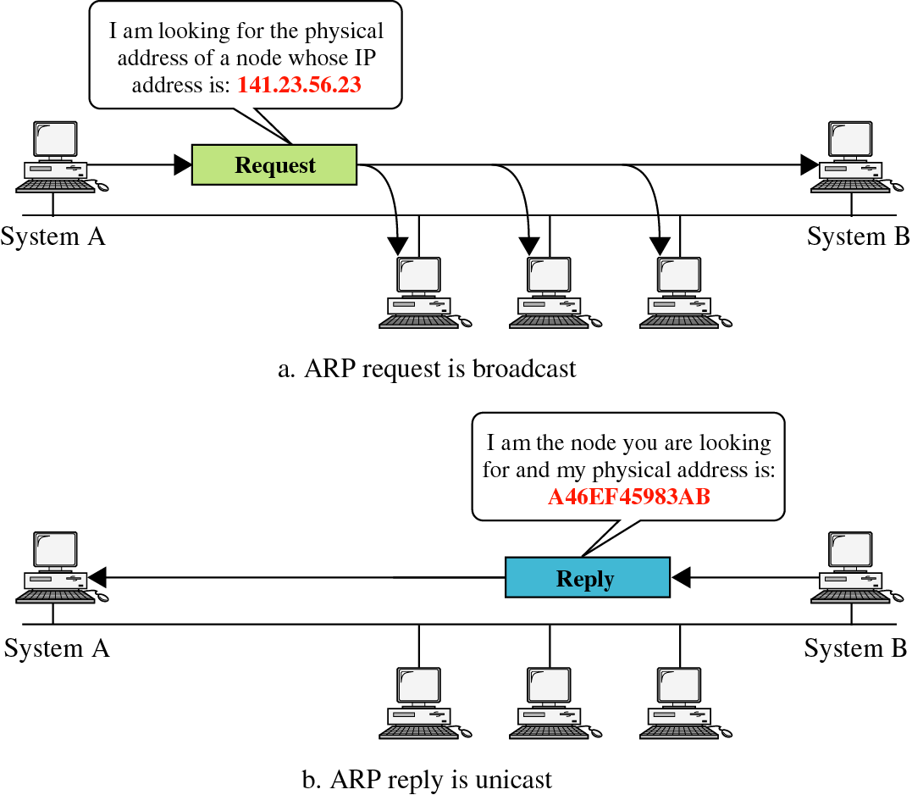
Figure 8-2
ARP
Notes:
Demo for arp
"arp -d <ip_address>" to delete an entry

Slide 7
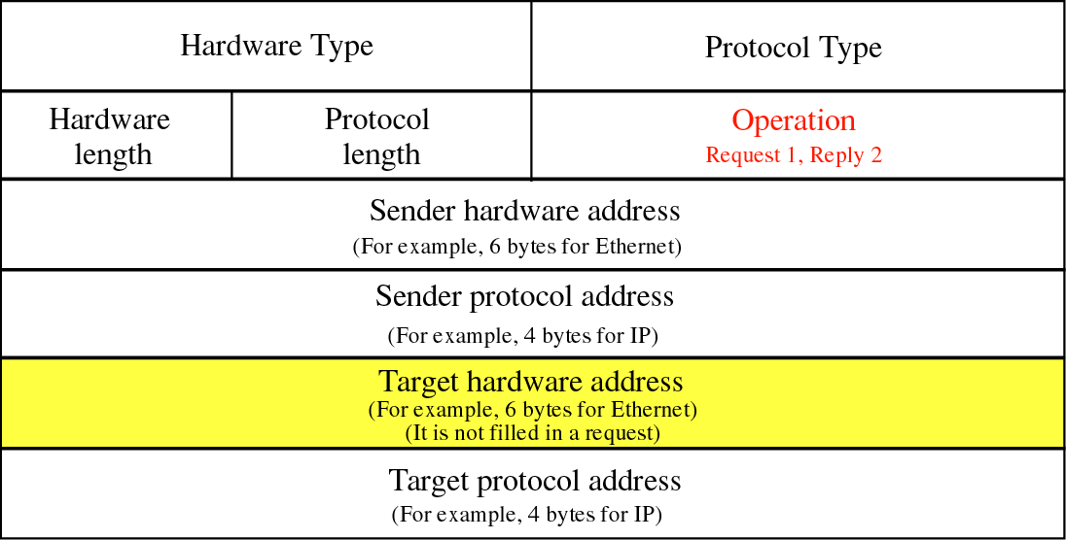
Figure 8-3
Structure of an ARP packet:
Notes:
Demo

Slide 8
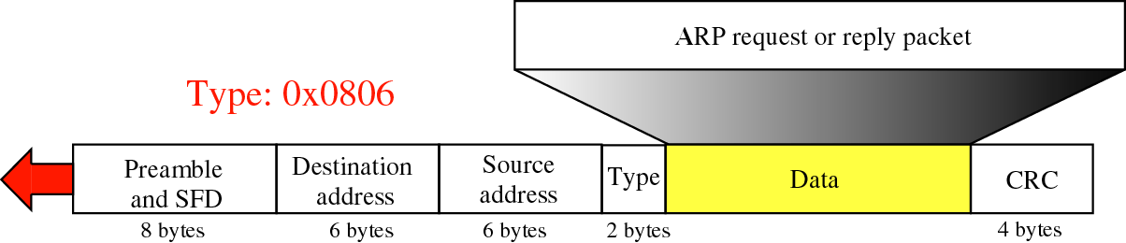
Figure 8-4
(ARP)
Preamble (7 bytes) is used for synchronization
SFD (Start Frame Delimiter, 1 byte) indicates the start of the frame
Encapsulation of ARP in an Ethernet Frame
Notes:
Demo

Slide 9
How ARP functions:
Get IP address of target.
Create a request ARP message
Fill sender physical address
Fill sender IP address
Fill target IP address
Target physical address is filled with 0
The message is passed to the Ethernet layer where it is encapsulated in a frame.
Source address: physical address of the sender.
Destination address: broadcast address.

Slide 10
Every host or router on the LAN receives the frame.
All machines check the ARP data.
All machines except the one targeted drop the packet.
The target machine replies with an ARP message that contains its physical address.
A unicast message.
The sender receives the reply message and knows the physical address of the target machine.

Slide 11
A’s ARP request
ARP request packet
Sender Hardware Address - A’s MAC address
Sender Protocol Address – A’s IP address
Target Hardware Address – Zeroes
Target Protocol Address – B’s IP address
Ethernet layer
Source Hardware Address – A’s MAC address
Target Hardware Address – FF:FF:FF:FF:FF:FF

Slide 12
B’s ARP reply
ARP reply packet
Sender Hardware Address - B’s MAC address
Sender Protocol Address – B’s IP address
Target Hardware Address – A’s MAC address
Target Protocol Address – A’s IP address
Ethernet layer
Source Hardware Address – B’s MAC address
Target Hardware Address – A’s MAC address

Slide 13
To avoid having to send an ARP request packet every time, a host can cache the IP and the corresponding host addresses in its ARP cache (or ARP table).
Each entry in the ARP cache is usually “aged” so that the contents are erased if no activity occurs within a certain period.
When a computer receives an ARP reply, it will update its ARP cache.
ARP is a stateless protocol, most operating systems will update their cache if a reply is received, regardless of whether they have sent out an actual request.
Notes:
Demo for arp
"arp -d <ip_address>" to delete an entry

Slide 14
Target IP Address of ARP
Consider a network that each connected device is either a host or a router
When a device sends an ARP request to resolve the IP address to the MAC address of another device in the same network, there are 4 cases:
Case 1: Host → Host
Case 2: Host → Router
Case 3: Router → Router
Case 4: Router → Host
The following shows the target IP addresses of ARP request for the 4 cases

Slide 15
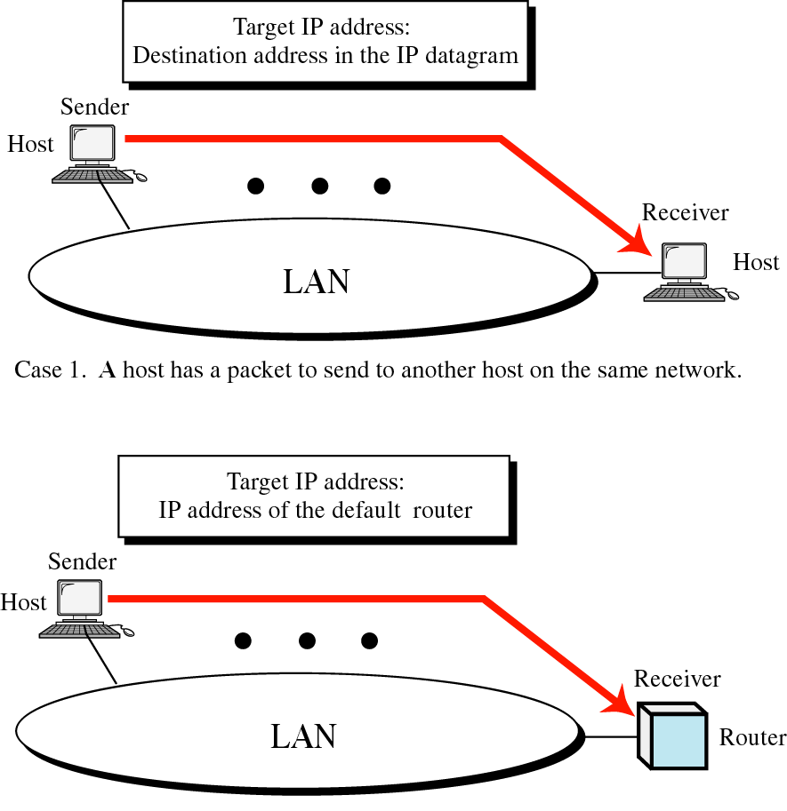
Figure 8-5, Part I
Case 2. A host wants to send a packet to another host on another network. It must first be delivered to a router.
Notes:
Demo for Case 2 – ping a computer outside the network, then check the target IP Address of the ARP Request

Slide 16
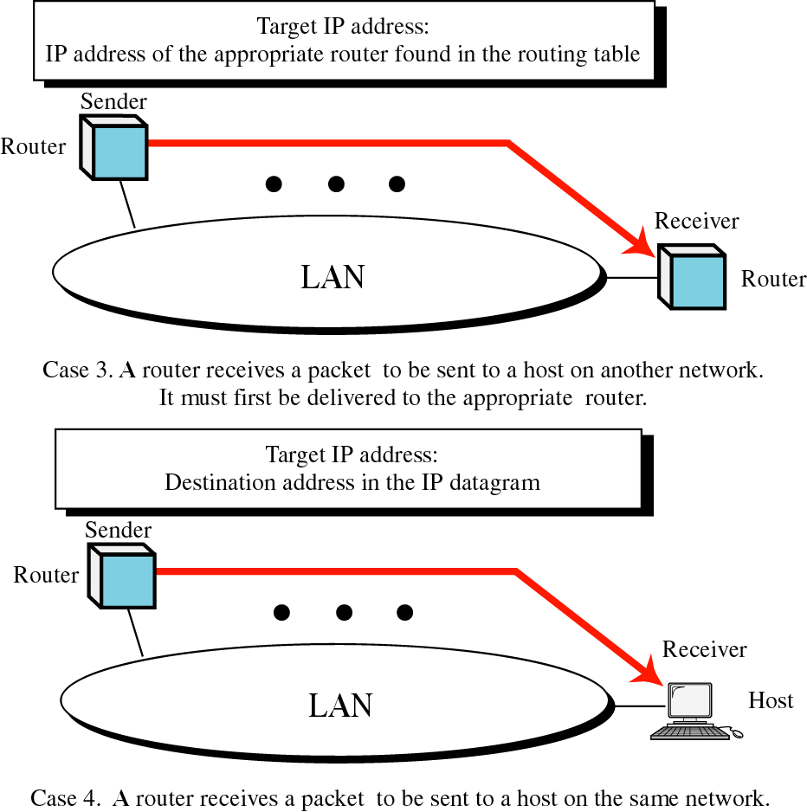
Figure 8-5, Part II

Slide 17
Proxy ARP
Proxy ARP is the process in which one system responds to the ARP request for another system.
In other words, A sends an ARP request to resolve the IP address of B. Instead of B, another host C responds to this ARP request.
Imagine that A and B are in different networks and C is a router connecting these two networks
When a router receives ARP requests from one network for hosts on another network, the router will respond with an ARP reply packet with the router’s MAC address.

Slide 18
Proxy ARP
For example, suppose host A is in one network, host B is in another network, and router C connects these two networks.
When host A sends an ARP request to resolve the IP address of host B, router C receives this packet.
Router C sends an ARP reply to host A with its MAC address.
In the ARP reply: B’s IP + C’s MAC address
So host A will send all the packets destined for host B to router C.
Router C will then forward these packets to host B.
In this case, router C can use proxy ARP to route packets from host A to host B.

Slide 19
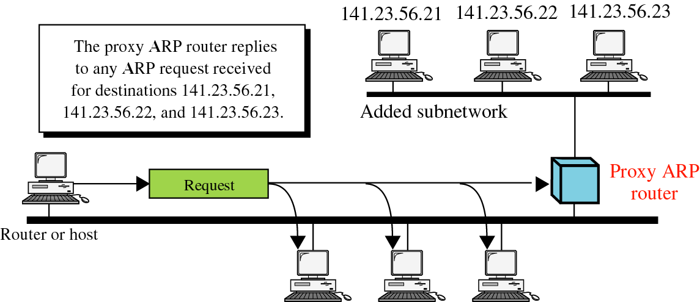
Figure 8-6
ARP Request: What is the MAC address of 141.23.56.21?
ARP Reply from router: 141.23.56.21 is at <router's MAC address>

Slide 20
References
Forouzan, “TCP/IP protocol Suite”., Chapter 8. (Background of ARP)

